Slide 1
How to Cut Data

Slide 2
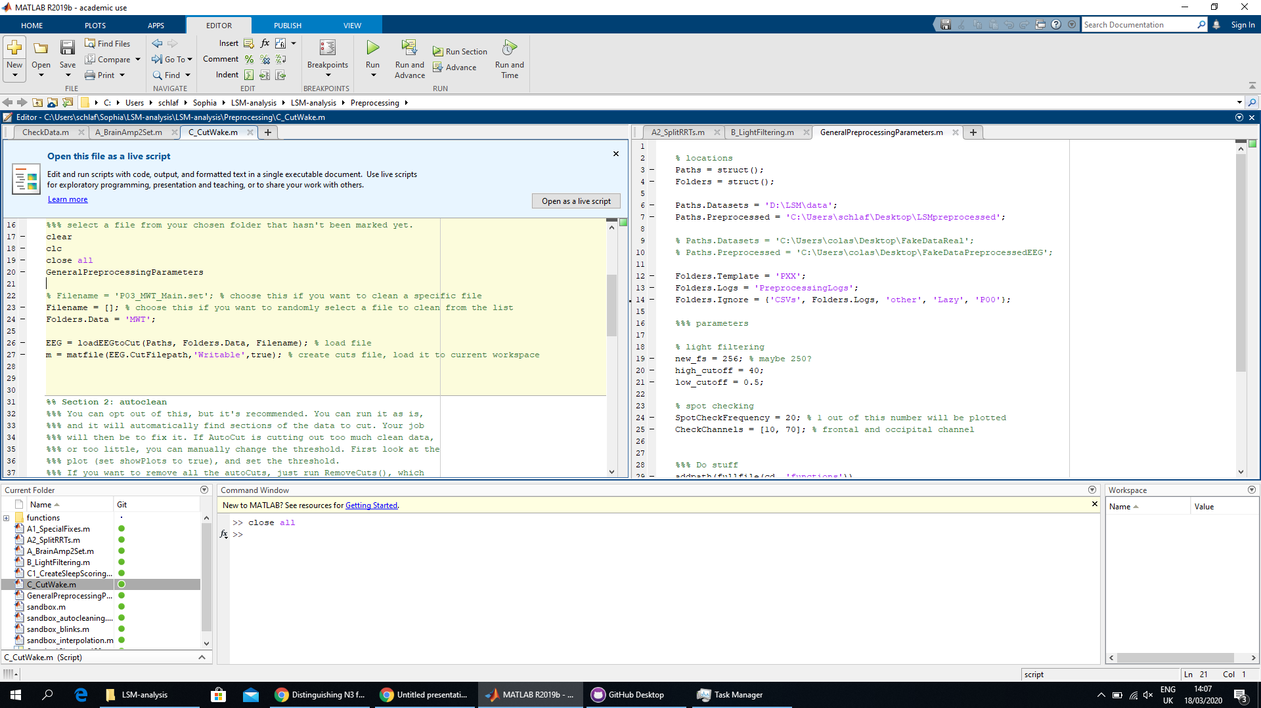
Be in the folder where the C_CutWake.m file is
Change paths for your computer
Specify the folder you want to clean
Run the sections in order
Run all other functions from here

Slide 3
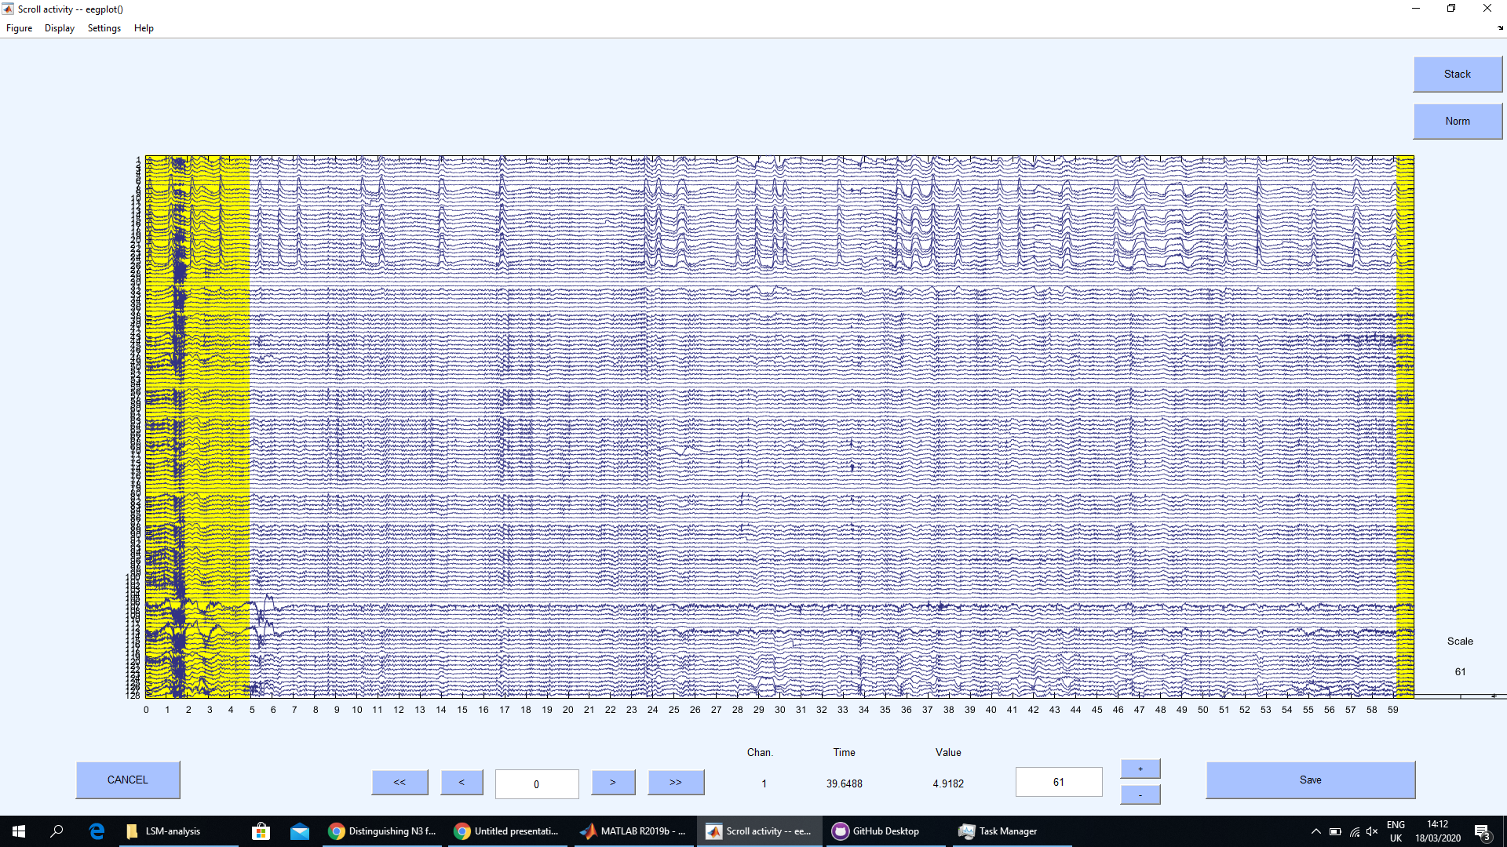
AutoCut() highlights suggested cuts in yellow
At the start of each session, set to 50 (I tend to forget)

Slide 4
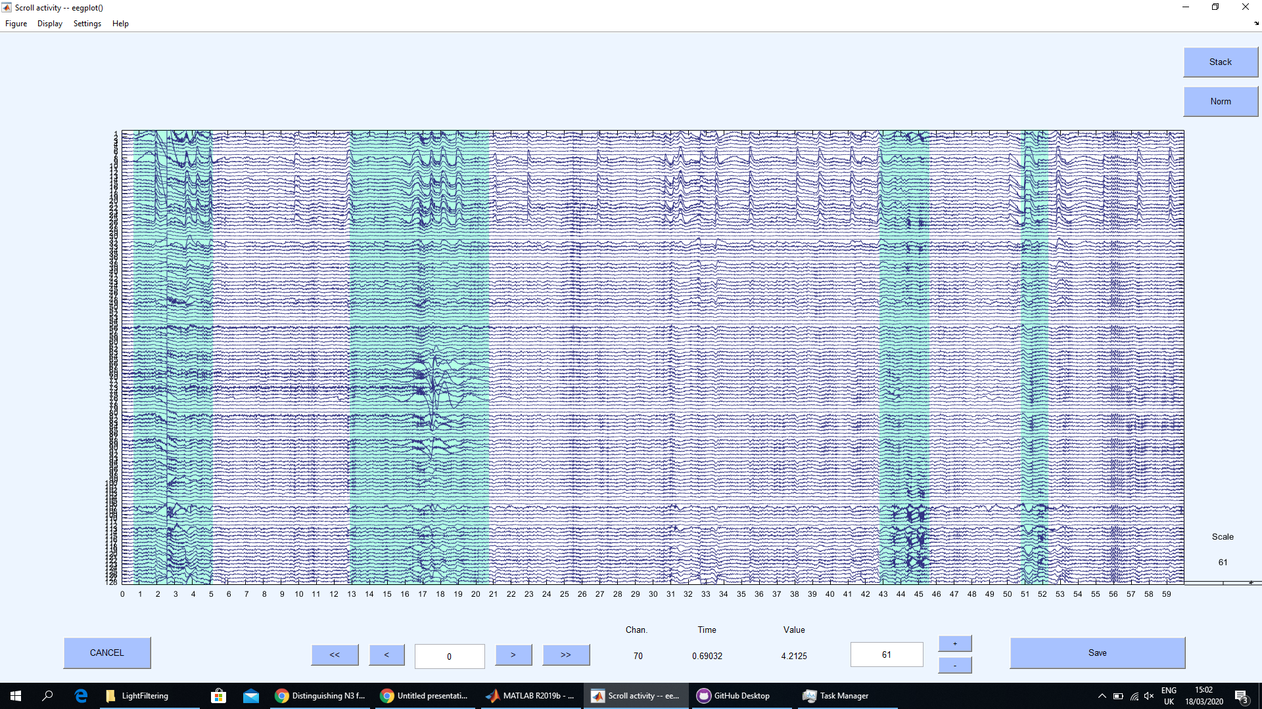
To manually add a section to remove, just click and drag over the data

Slide 5
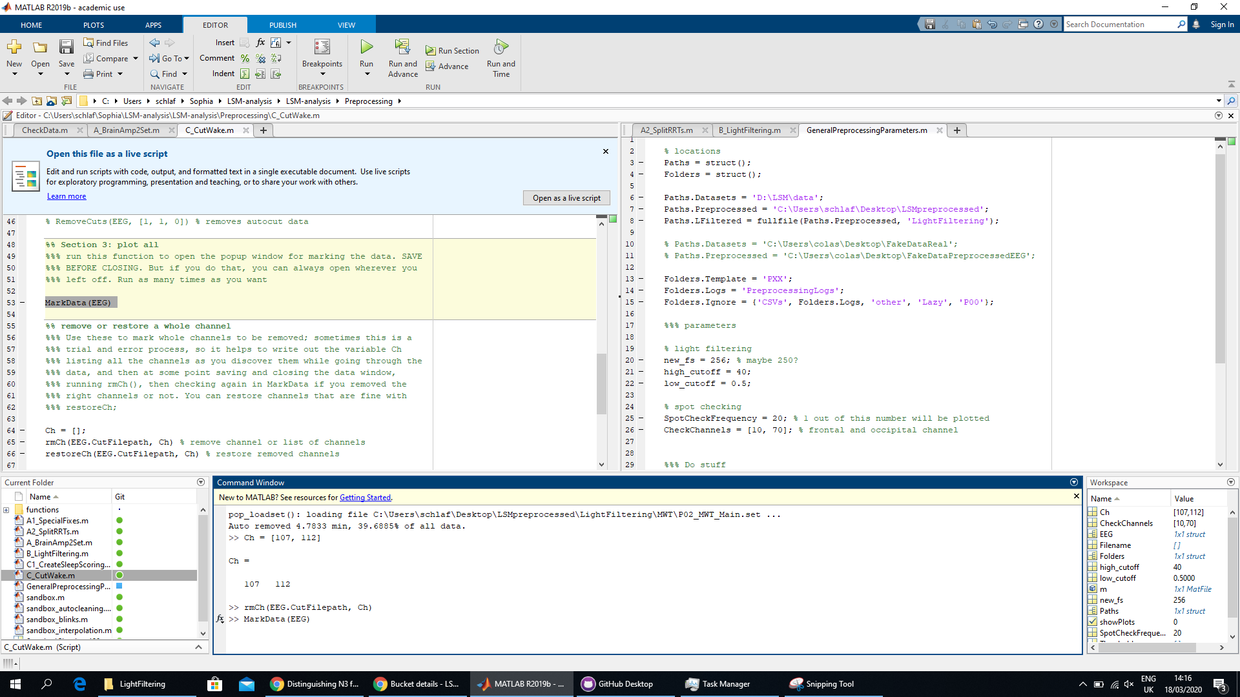
To remove channels, write them in a list, then run rmCh(), and see your choice by running MarkData() again. If you got the channel wrong, run restoreCh()
Here you can see which file you’re working on; but only look if you need to report something weird

Slide 6
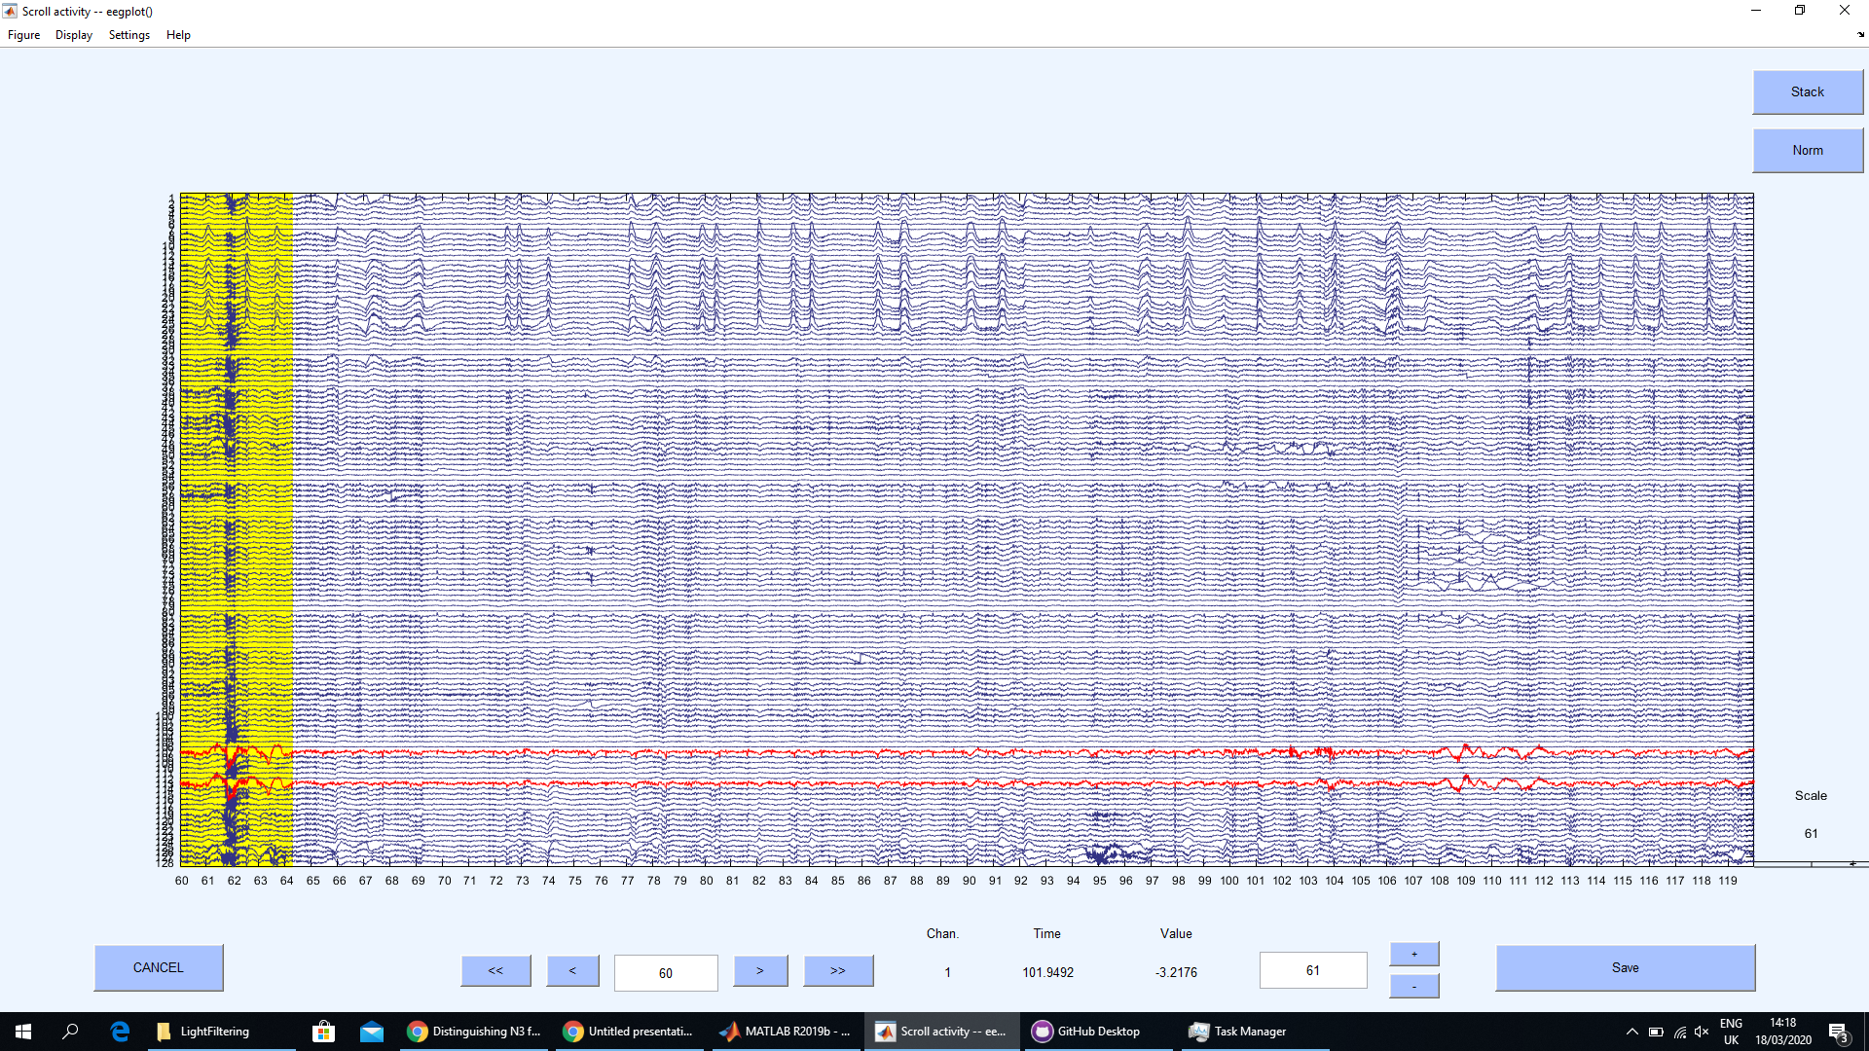
Not worth it
Removed channels are highlighted in red. These are actually the mastoid channels; I will later remove them anyway, but if they bother you, you can mark them already now
Not worth it

Slide 7
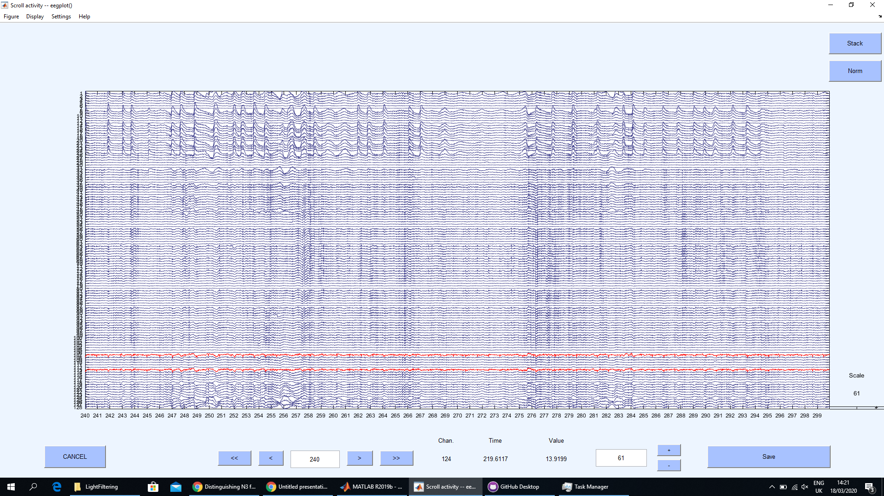
This is nice, clean data
Don’t worry about events synchronized to eye movements, these are removed with ICA

Slide 8
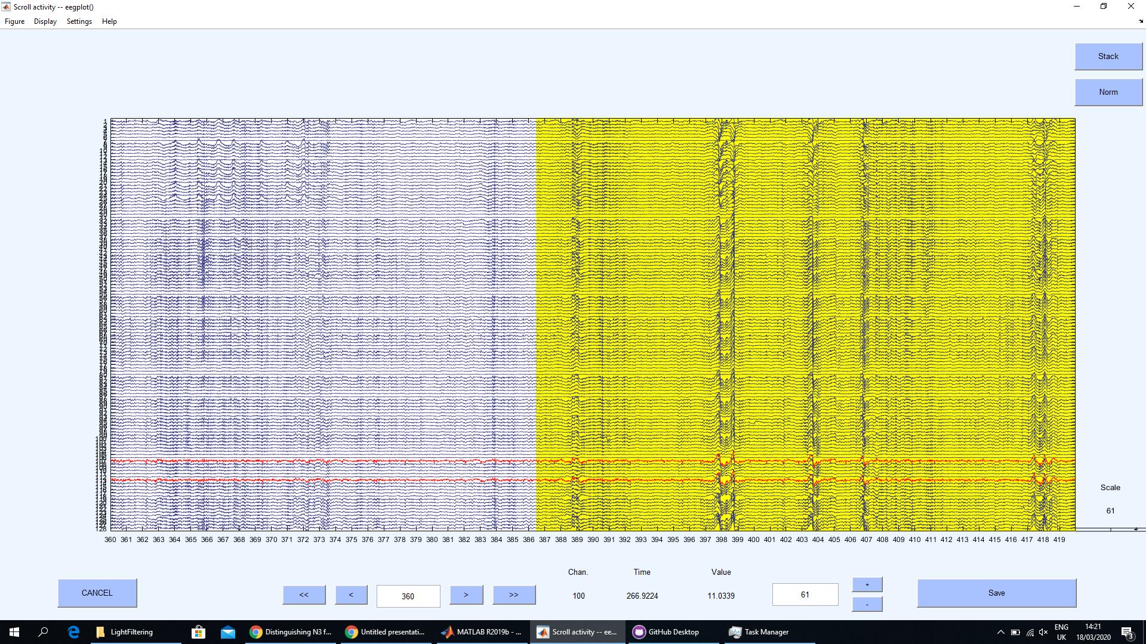
This is also clean data, but slow waves, and the autocorrector is wrong (it thinks sleep is noise)

Slide 9
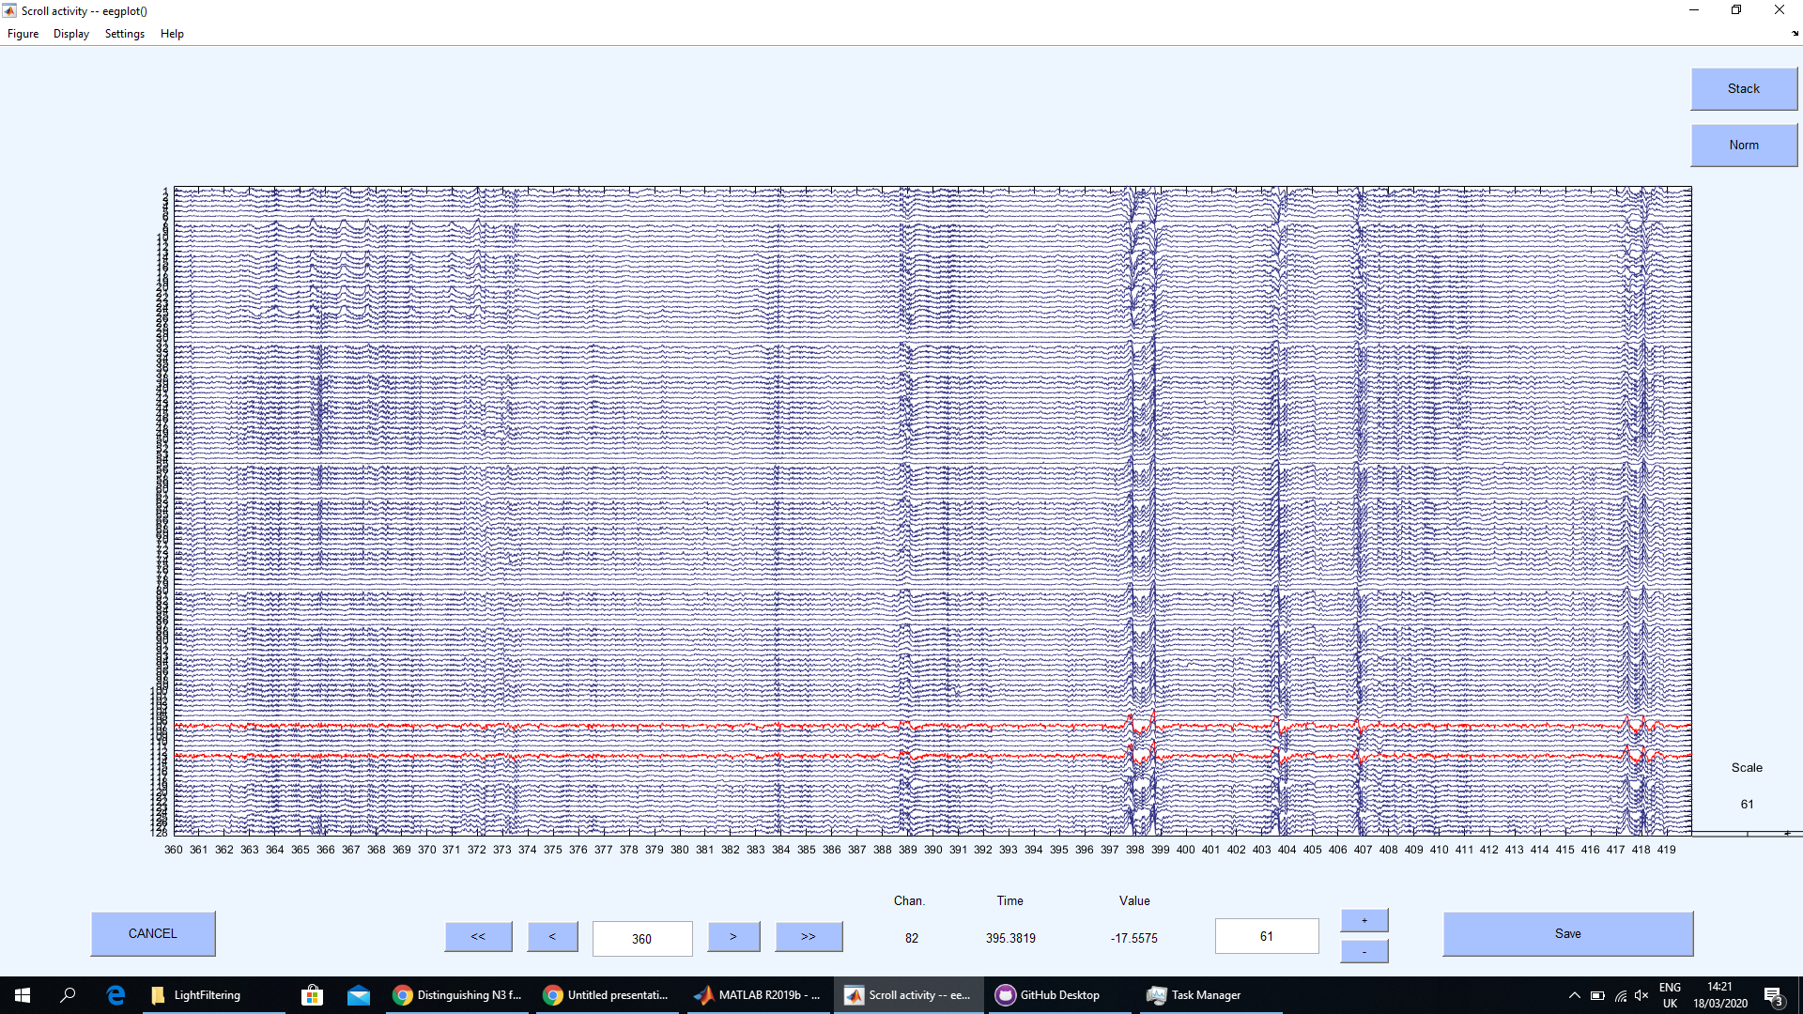
So just click on the yellow area, and it will go away

Slide 10
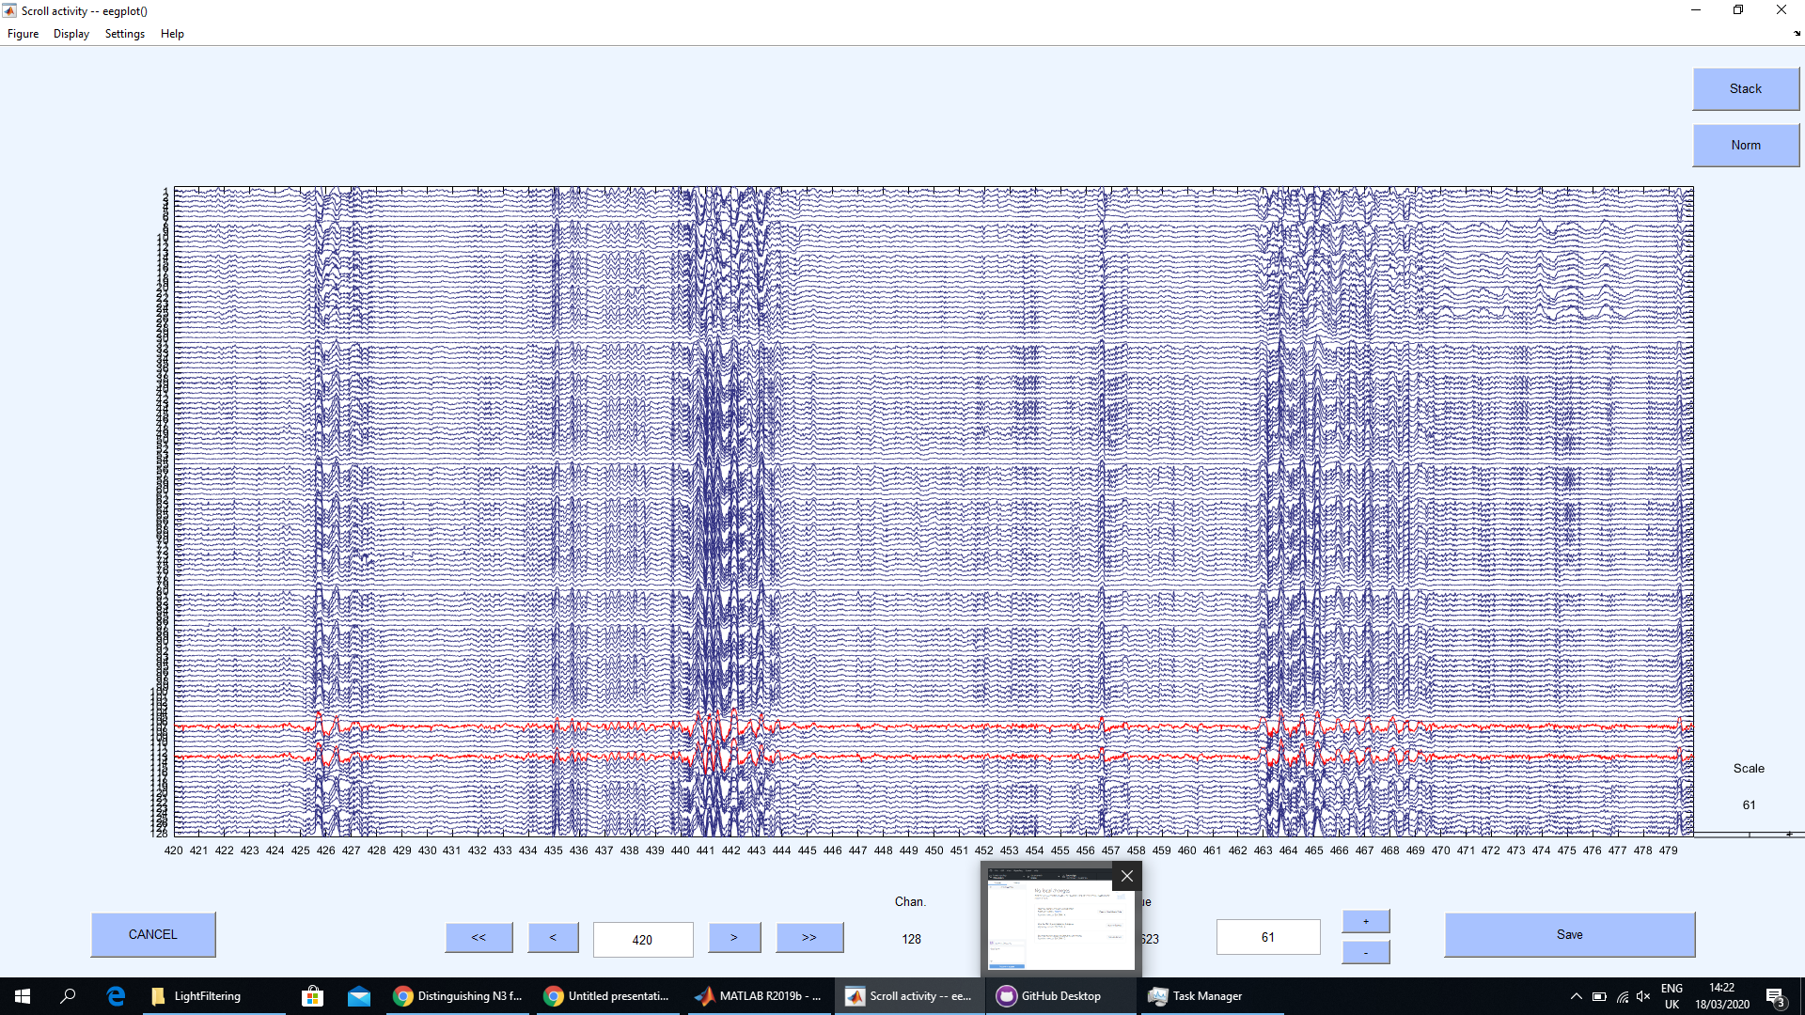
Also sleep, clean data

Slide 11
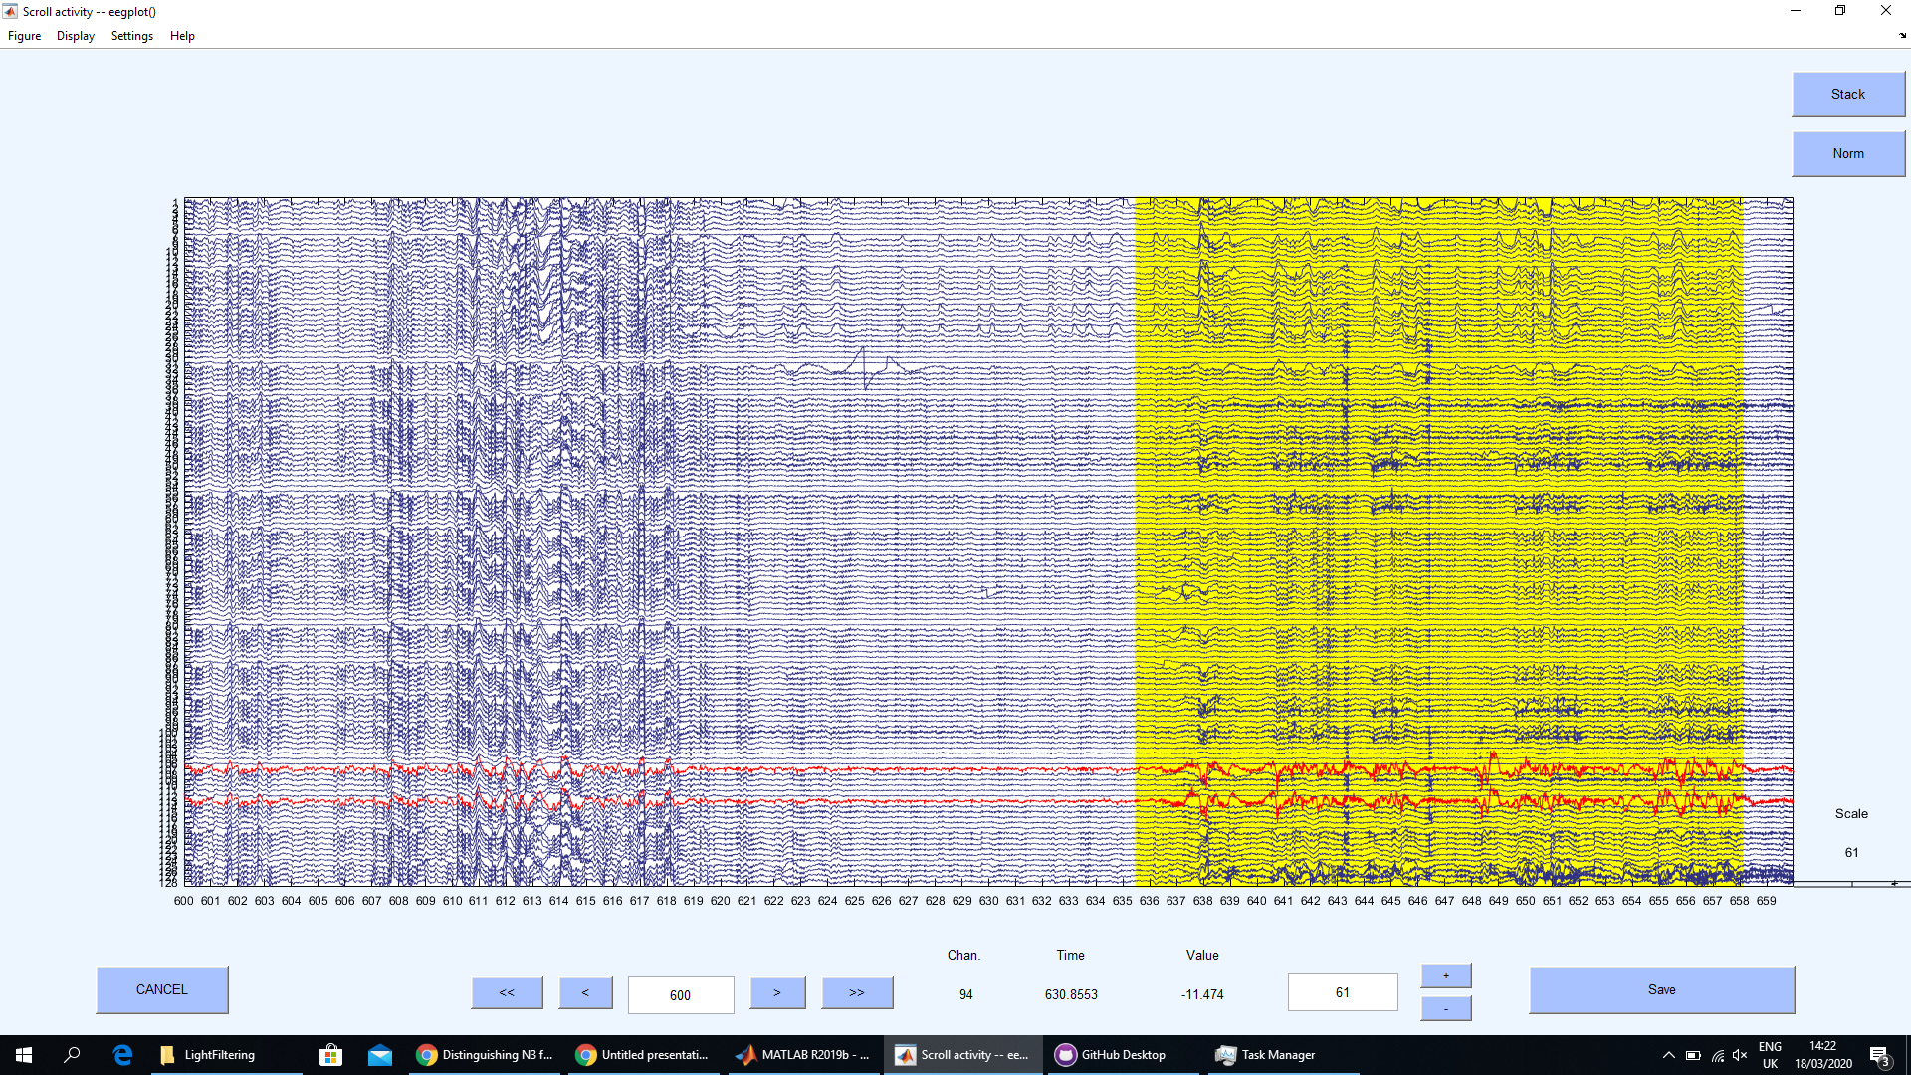
Borderline bad data; more filtering gets rid of it, so if you don’t have a lot of data, don’t bother cutting it out
Single channel problem can be removed from command window

Slide 12
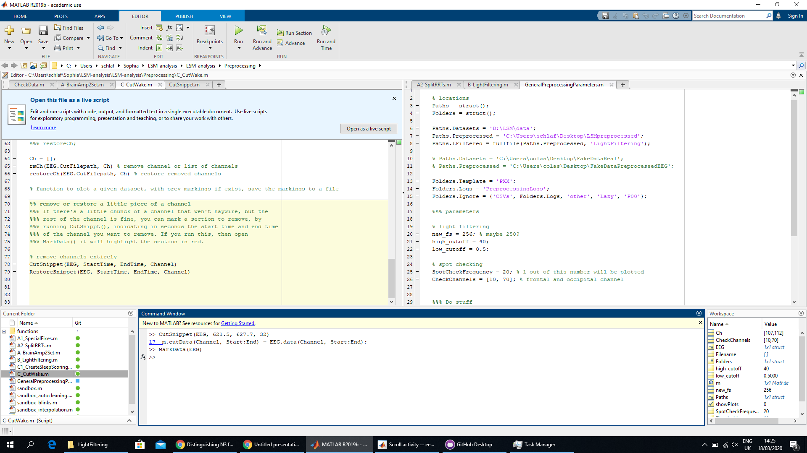
Indicate start and end time, and channel to remove segment

Slide 13

Once you restart the data viewer it will be marked in red.
TIP: only check that these segments were correctly removed AFTER you’ve gone through all the data; displaying them slows things down

Slide 14
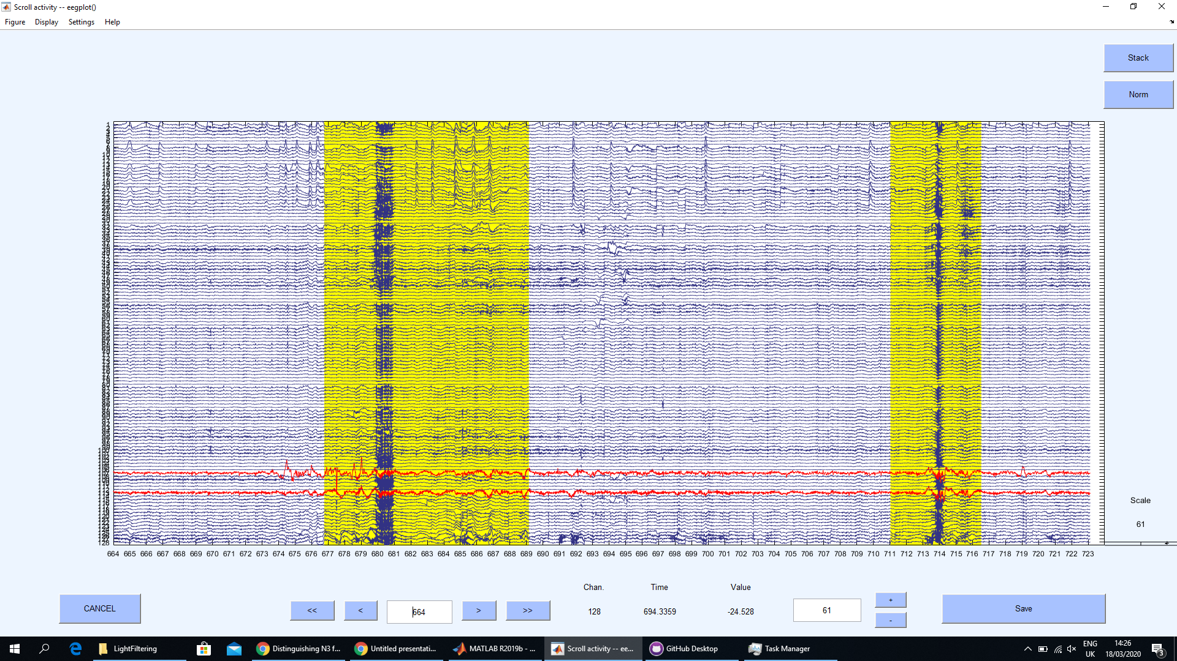
In this case, this cuts out more than is needed, so click and redraw.

Slide 15
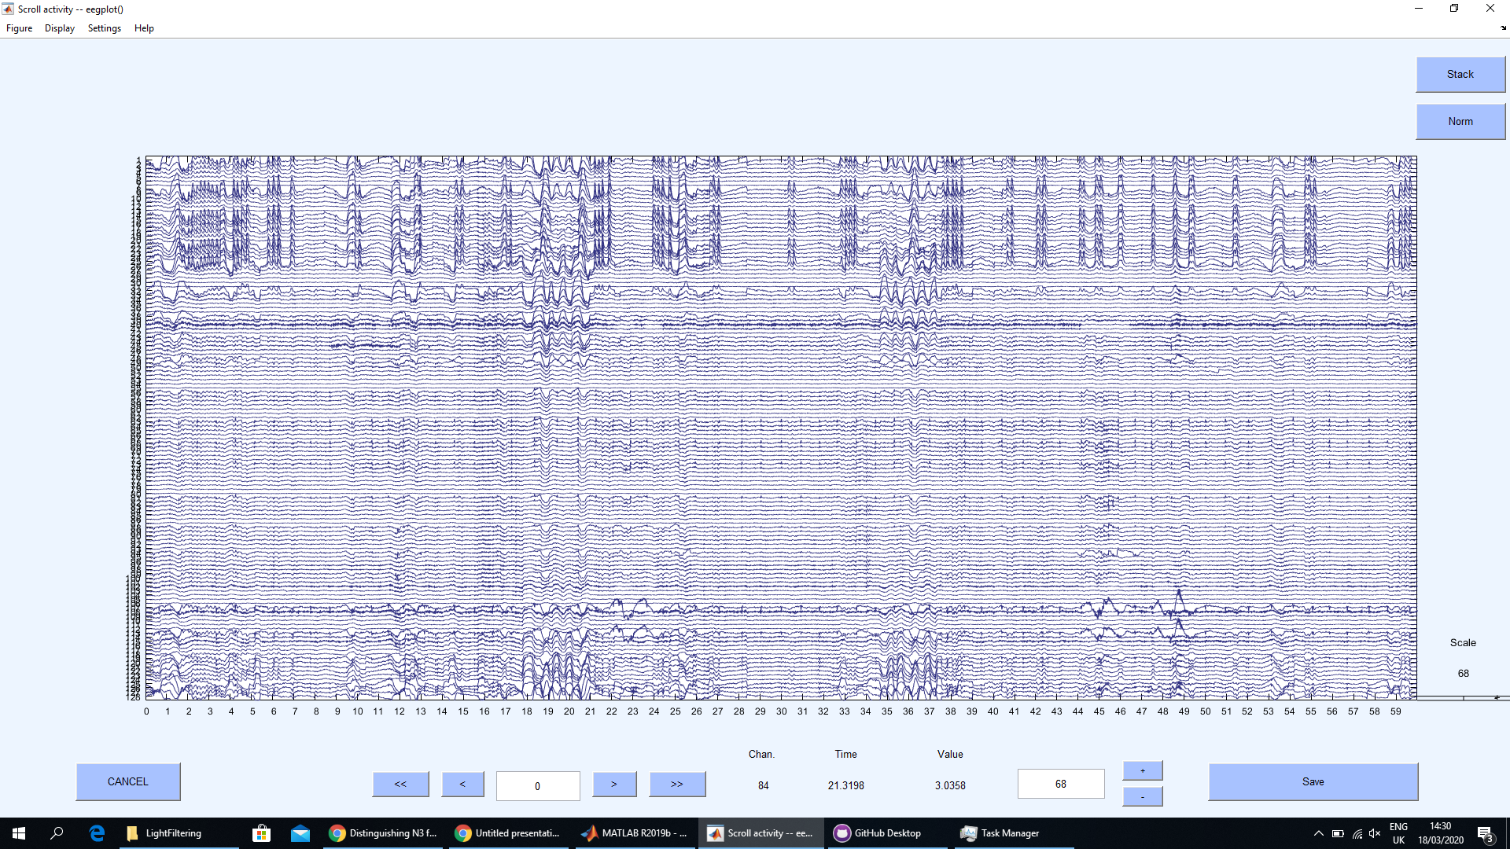
When you see something super weird, send a screenshot to Sophia, be sure to mention the filename, and include in the shot the time range

Slide 16
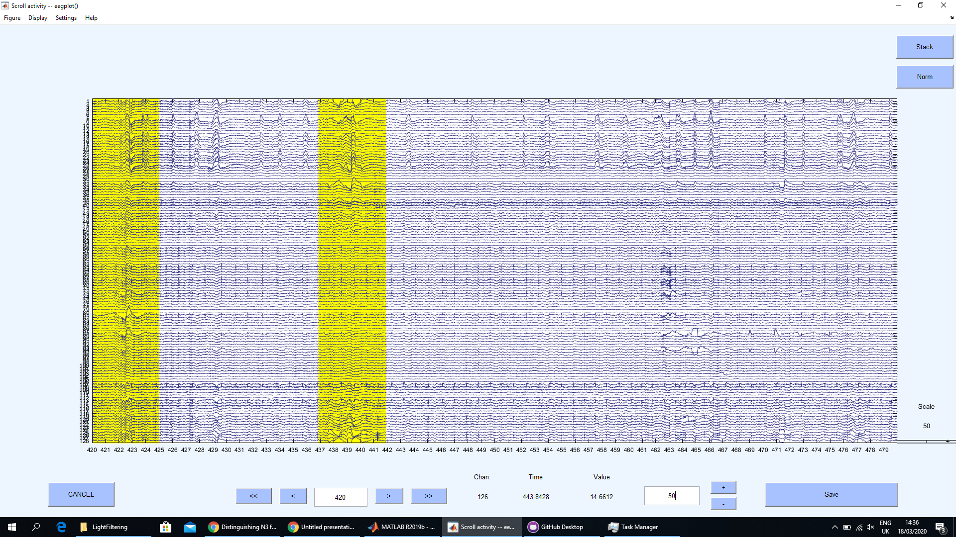
Here, the autocut was very wrong, because in this participant, eye movements show up in back channels as well; both segments should be unselected

Slide 17
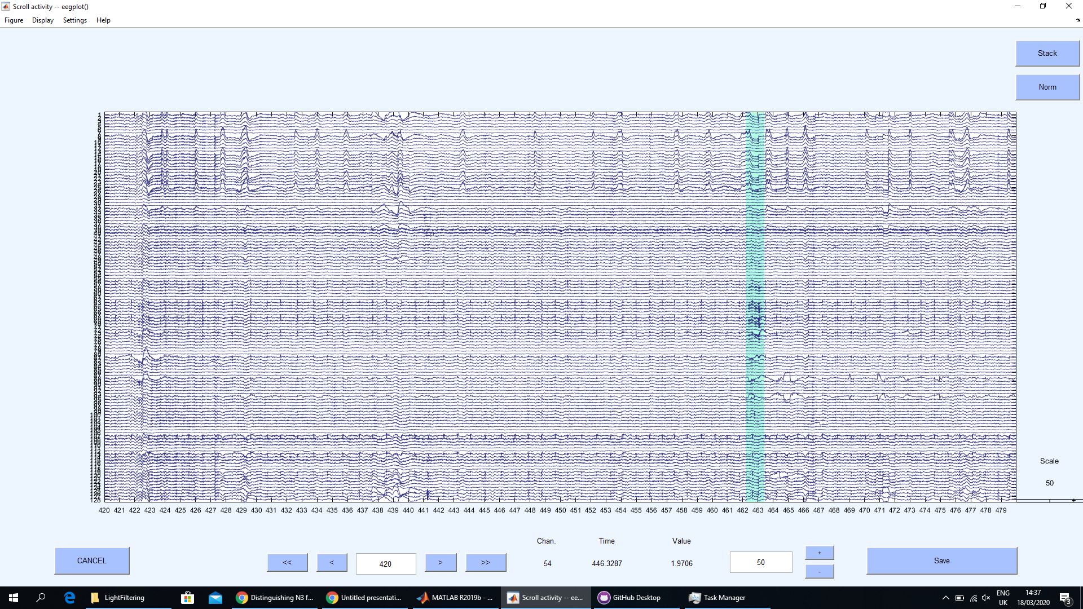
This thingy is more of a problem

Slide 18
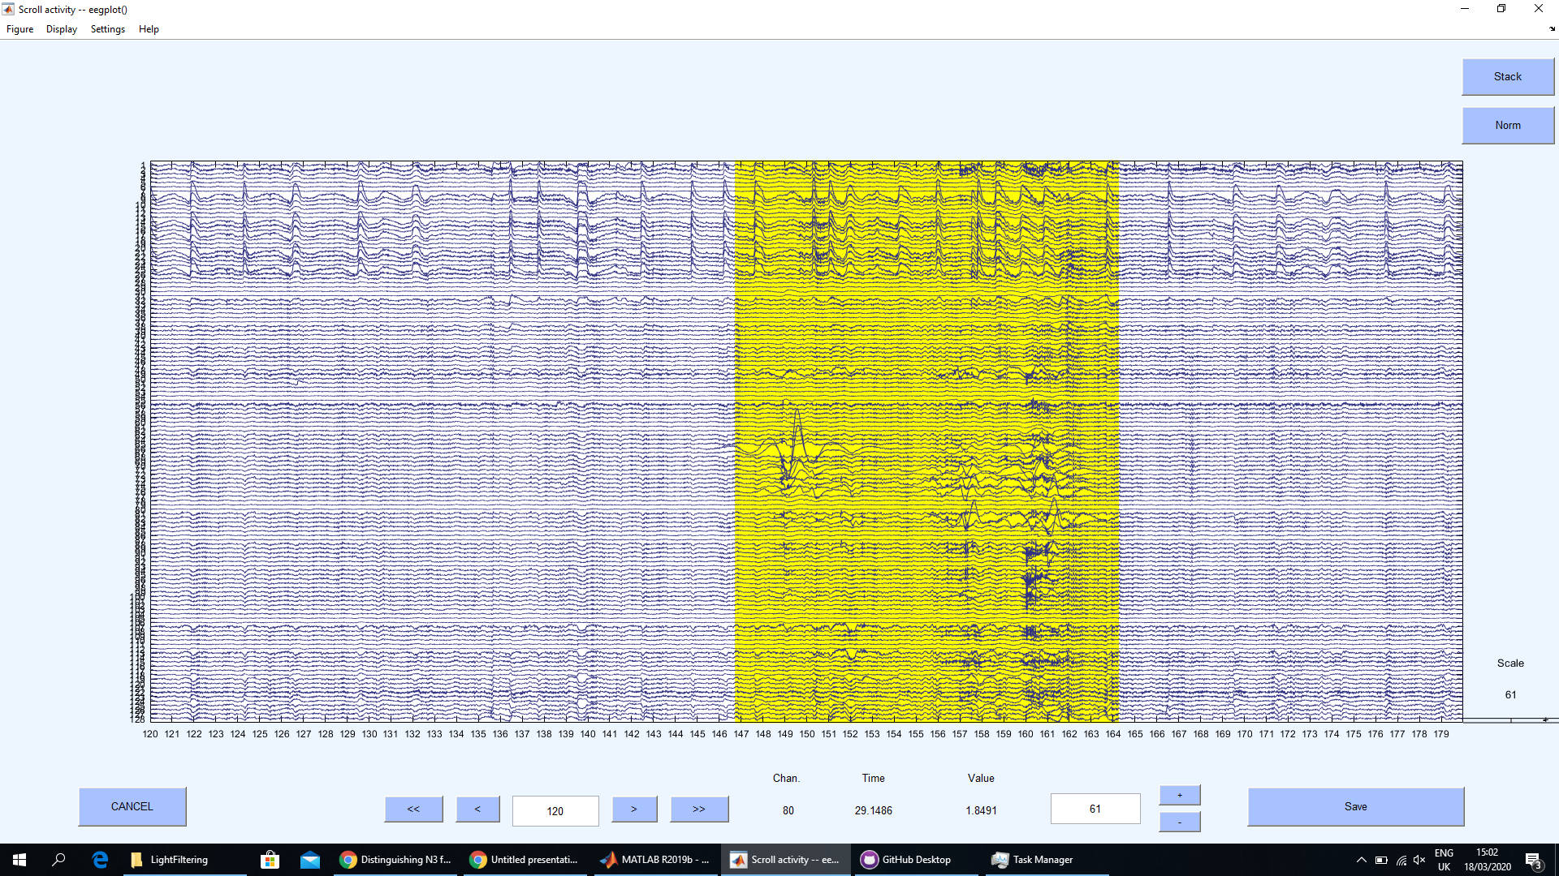

Slide 19
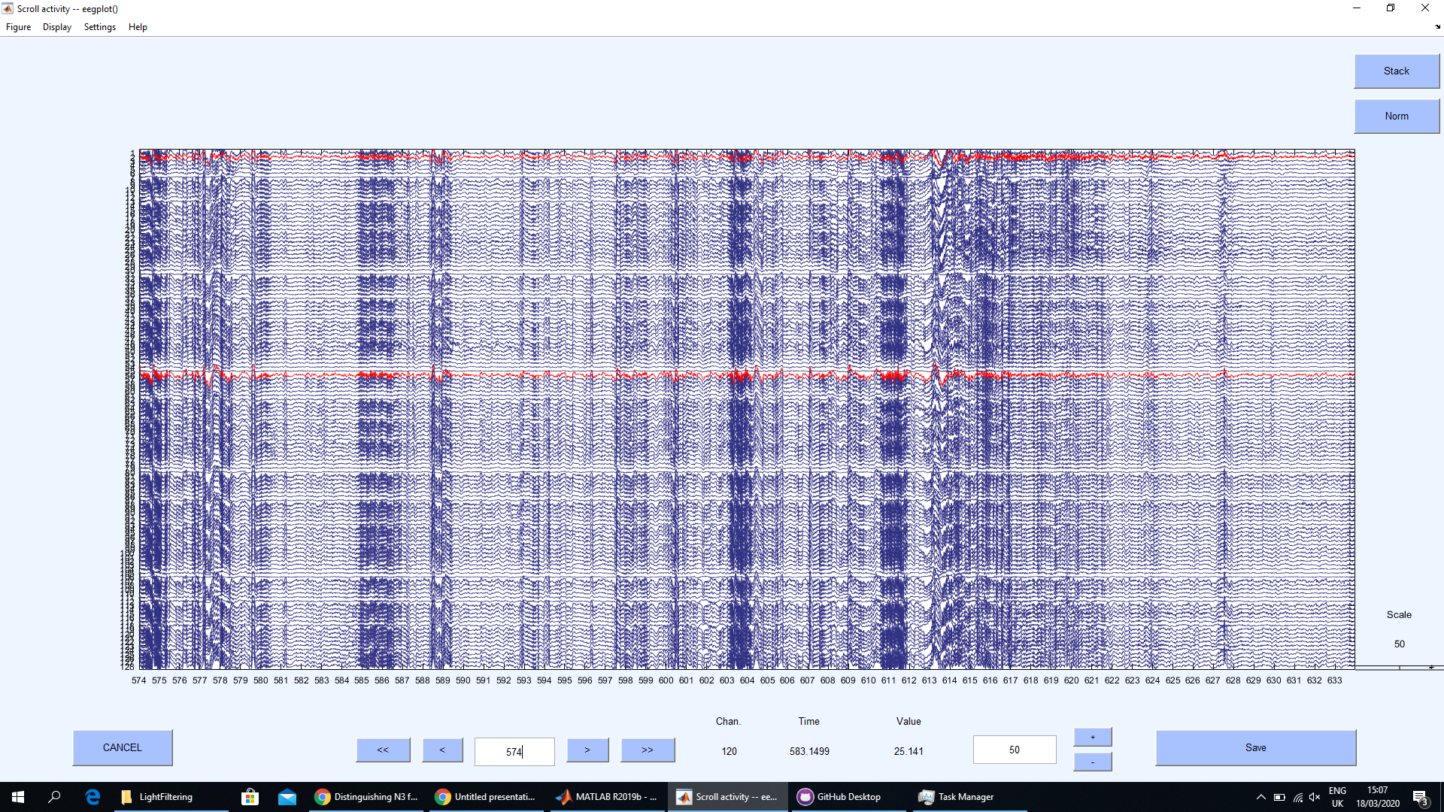

Slide 20
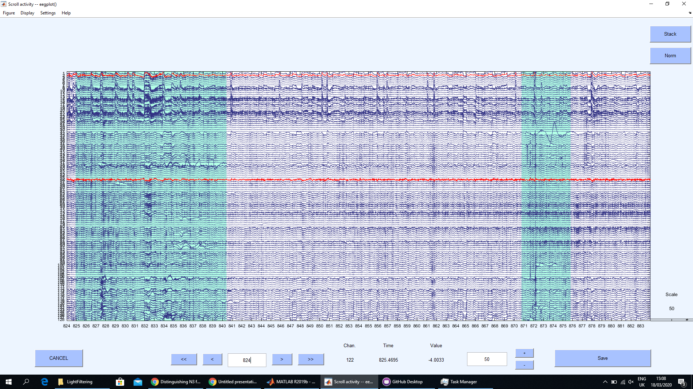
Here there’s these weird spike things; thin spikes are very bad, get rid of them

Slide 21
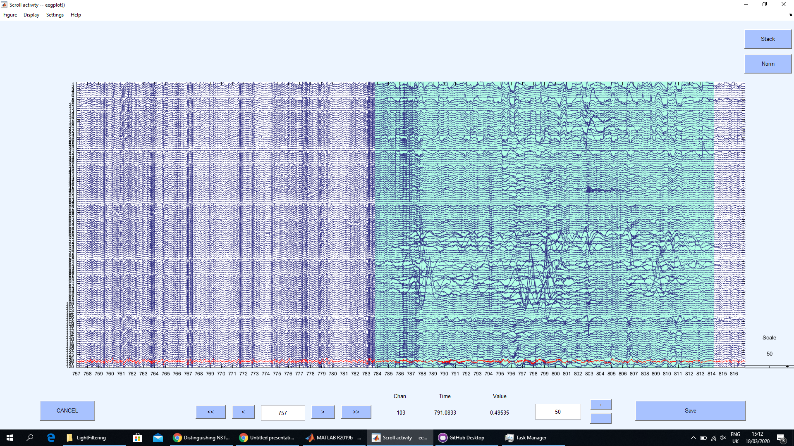

Slide 22
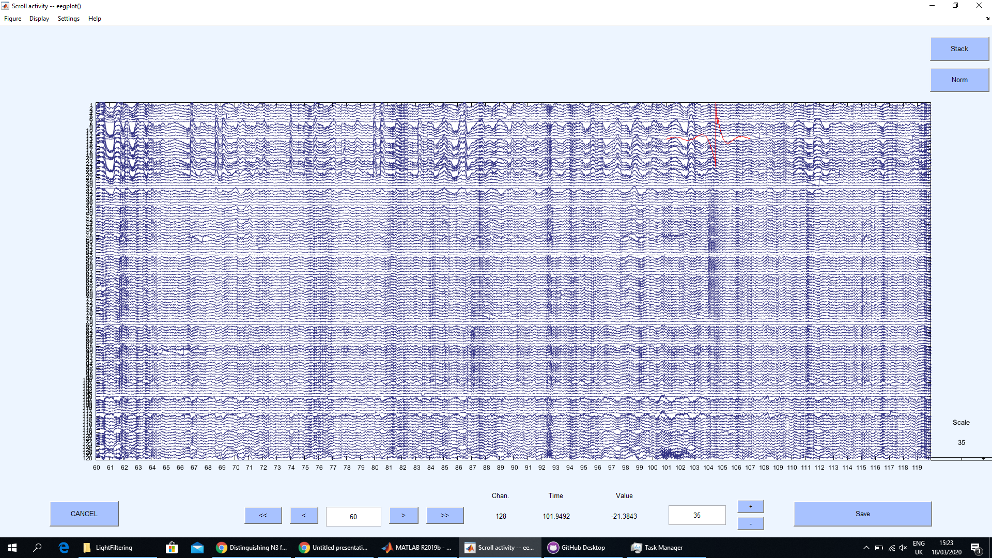
When needed, can remove just this

Slide 23
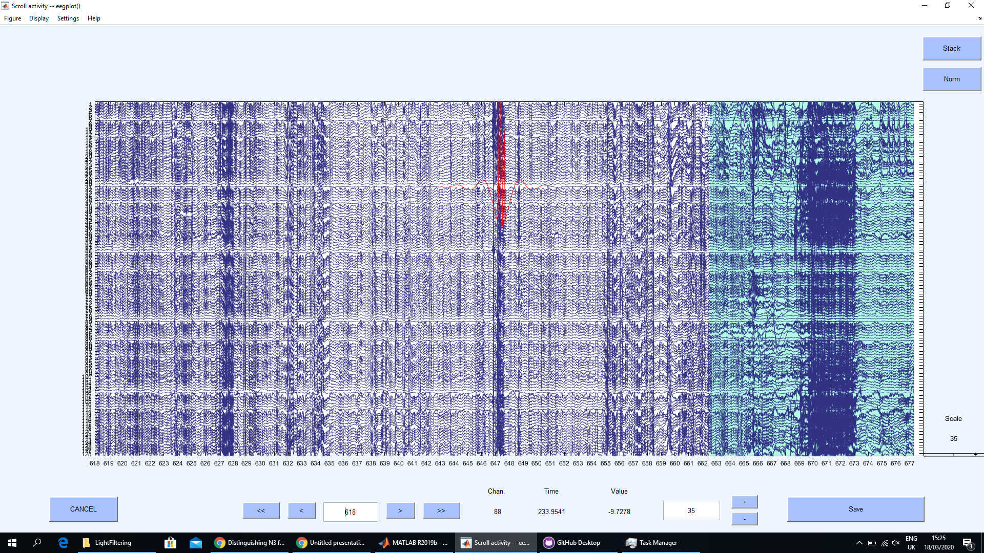
This is muscle activity from the person waking up
This is a beta burst, and not noise

Slide 24
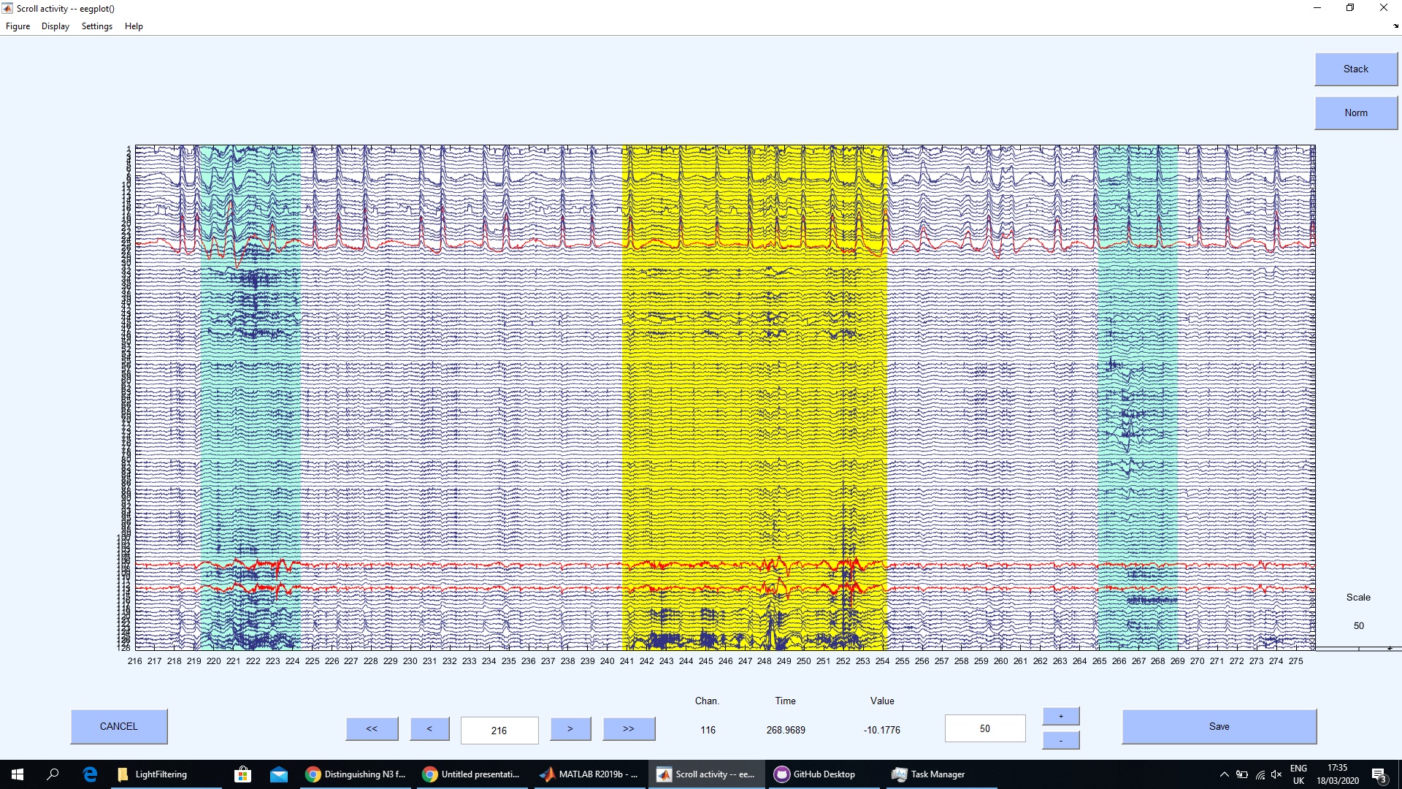
This channel is a little more psycho than usual
These are the worst

Slide 25
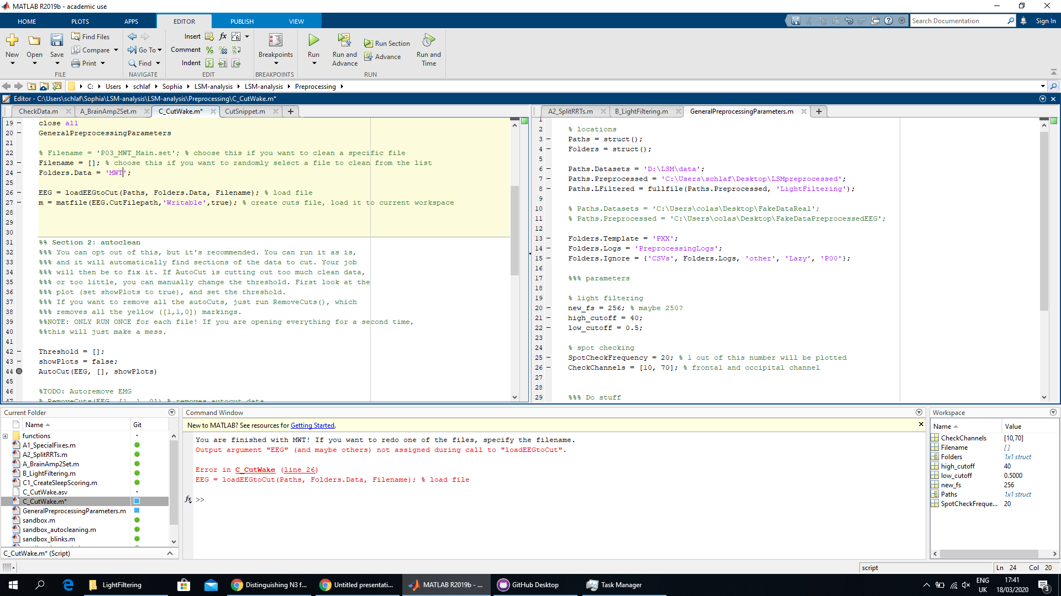
When you’ve done all the recordings, you get this error message

